Slide 1


Gaurab Kundu
₁₂th
of October-2021

Slide 2
Outline
Executive Summary
Introduction
Methodology
Results
Conclusion
2

Slide 3
Executive Summary
The objective of this thesis is to give a complete explanation on how to apply a complete data-driven analytic approach.
The report focus on collecting data by web scrapping or API calls, perform EDA and visualize the data before building a classification machine learning models to predict whether the landing will succeed or not.
3

Slide 4
Introduction
In the age of commercial space travelling, SpaceX advertises Falcon 9 rocket launches on its website with a cost of 62 million dollars; other providers cost upward of 165 million dollars each, much of the savings is because SpaceX can reuse the first stage.
The aim of this data science project is to predict if the Falcon 9 first stage will land successfully, therefore if we can determine if the first stage will land, we can determine the cost of a launch. This information can be used if an alternate company wants to bid against SpaceX for a rocket launch.
4

Slide 5

5

Slide 6
Data Collection
The data set used in the project is the SpaceX Lunch data.
The data set contains information about different flights including date, lunch site,
booster version and more
The data is collected by two main approaches:
The SpaceX API
Web scrapping
6

Slide 7











Data Collection – SpaceX API
We’ll be collecting lunch data from SpaceX API, First we request lunch data from SpaceX API using the GET command (requests.get), then we create a pandas dataframe from the response, After that we make several sub requests to get more detailed and consistent information about the IDs stored in the dataframe.
With the help of some helper functions, we save the responses into a dictionary, and then we transform it into a dataframe, which is our data set.
Request Rocket data from SpaceX API
Response
Save them in Dictionary
Request data from the SpaceX API
Request Lunchpad data from SpaceX API
Response
Response
Request Payloads data from SpaceX API
Response
Create a
dataframe
Request cores data from SpaceX API
Response
Create a
dataframe
https://github.com/GaurabKundu1/IBM-Data-Science-Professional-Certificate-Appiled-Data-Science-Capstone-Project/blob/main/jupyter-labs-spacex-data-collection-api.ipynb
7

Slide 8



Data Collection - Scraping
We’ll will be performing web scraping to collect Falcon 9 historical launch records from a Wikipedia page, first we perform an HTTP GET( using requests.get command) method to request the Falcon9 Launch HTML page, as an HTTP response, then we create a BeautifulSoup object from the HTML response, we extract the column names from the object and use it as dictionary keys.
We parse the HTML tables and fill the dictionary keys with lunch records from table rows, and finally we transform it into a dataframe.
HTTP Request from Wikipedia’s page
Extract column names
Create a dataframe
Save them in Dictionary
HTTP Response
BeautifulSoup Object
parse the launch HTML tables
https://github.com/GaurabKundu1/IBM-Data-Science-Professional-Certificate-Appiled-Data-Science-Capstone-Project/blob/main/jupyter-labs-spacex-data-collection-api.ipynb
8

Slide 9
Data Wrangling
Exploratory data analysis is an important step while preprocessing data, it is useful to find some patterns in the data and determine what would be the label for training supervised models.
This process was done in the following order:
First thing to do is to identify the data types of the columns.
Determine the number of values for each attribute.
Calculate the percentage of the missing values.
To determine the label, we apply zero/one hot encoding to the “Outcome” column to classify landing to either 1 (Success) of 0 (Failure)
https://github.com/GaurabKundu1/IBM-Data-Science-Professional-Certificate-Appiled-Data-Science-Capstone-Project/blob/main/labs-jupyter-spacex-Data%20wrangling.ipynb
9

Slide 10
EDA with SQL
In order to better understand the datasets, we ran the following SQL queries:
Display the names of the unique launch sites in the space mission
Display 5 records where launch sites begin with the string 'CCA'
Display the total payload mass carried by boosters launched by NASA (CRS)
Display average payload mass carried by booster version F9 v1.1
List the date when the first successful landing outcome in ground pad was achieved.
List the names of the boosters which have success in drone ship and have payload mass greater than 4000 but
less than 6000
List the total number of successful and failure mission outcomes
List the names of the booster versions which have carried the maximum payload mass. Use a subquery
List the failed landing outcomes in drone ship, their booster versions, and launch site names for in year 2015
Rank the count of landing outcomes (such as Failure (drone ship) or Success (ground pad)) between the date 2010-06-04 and 2017-03-20, in descending order
https://github.com/GaurabKundu1/IBM-Data-Science-Professional-Certificate-Appiled-Data-Science-Capstone-Project/blob/main/jupyter-labs-eda-sql-coursera.ipynb
10

Slide 11
EDA with Data Visualization
In order to understand the relations between different features, we visualize the data by plotting scatter plots, bar charts and line charts, it helps finding hidden patterns in data and gain insights about the dataset.
Pay load mass against the Flight number
Lunch site against the Flight number
Lunch site against the Pay load mass
Orbit type against Class success rate
Flight number against Orbit type
Orbit type against the Pay load mass
launch success yearly trend
https://github.com/GaurabKundu1/IBM-Data-Science-Professional-Certificate-Appiled-Data-Science-Capstone-Project/blob/main/jupyter-labs-eda-dataviz.ipynb
11

Slide 12
Build an Interactive Map with Folium
Here, we complete the interactive visual analytics using Folium.
First we create Folium map object, with an initial center location around Nasa Johnson space center, Houston-Texas.
We add a circle on the map for each lunch site from the dataset by creating a folium circle and folium marker, now the lunch sites are marked on the map which means we can see which one is proximate to the equator line or close to a coastline.
In order to mark the success/failure lunches, we create a marker on the map for each lunch record from the dataset, a green marker indicates a successful lunching and a red one indicates failure,
we need to explore and analyze the proximities of launch sites, we calculate the distance between the lunch site and its proximities and then we draw a polyline between them.
https://github.com/GaurabKundu1/IBM-Data-Science-Professional-Certificate-Appiled-Data-Science-Capstone-Project/blob/main/lab_jupyter_launch_site_location.ipynb
12

Slide 13
Predictive Analysis (Classification)
Now that we finished the exploratory analysis, the next step is to determine the training labels and build a
predictor using machine learning algorithms.
after using the ‘Class’ column as the label, first thing to do is normalizing the data.
We split the normalized data into test/train sets, The training data is divided into validation data, a second
set used for training data.
For the model development phase, we use the following algorithms:
Logistic regression
Support vector machine
Decision trees
K nearest neighbor
We build a grid search object for each of the algorithms and fit it to find the best parameters of the model(hyper parameters tuning), then we choose the most accurate model.
https://github.com/GaurabKundu1/IBM-Data-Science-Professional-Certificate-Appiled-Data-Science-Capstone-Project/blob/main/SpaceX_Machine%20Learning%20Prediction_Part_5.ipynb
13

Slide 14
Results
Success rate increased noticeably from 2013 and on.
lunch site and the orbit type are the features with the largest effect on the outcome.
KNN and SVM models have a validation set accuracy of
83% and an out of sample accuracy of 77%.
14

Slide 15


Slide 16
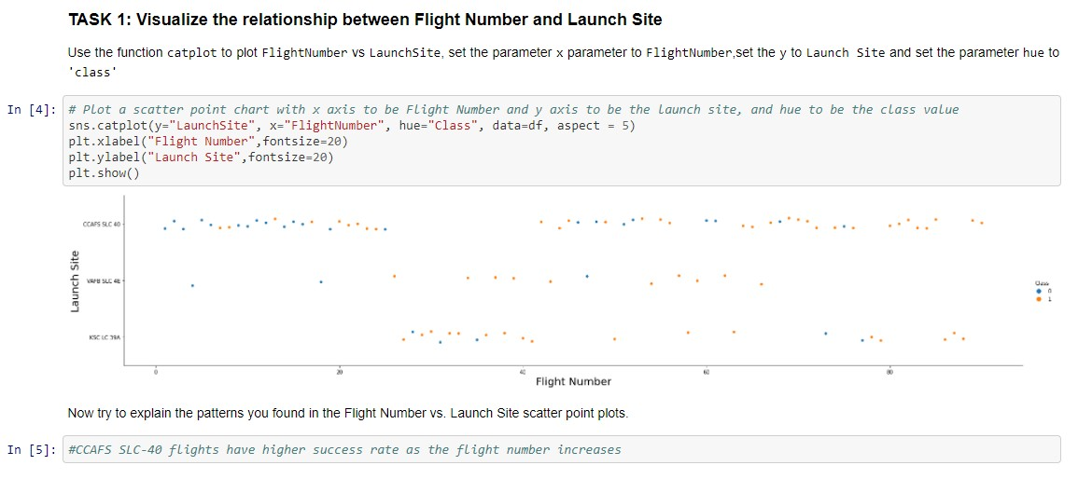
Flight Number vs. Launch Site

Slide 17
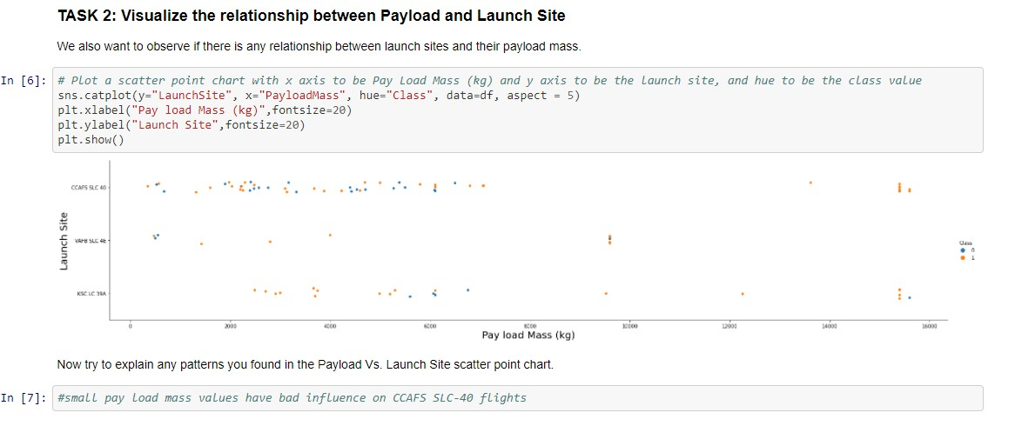
Payload vs. Launch Site

Slide 18
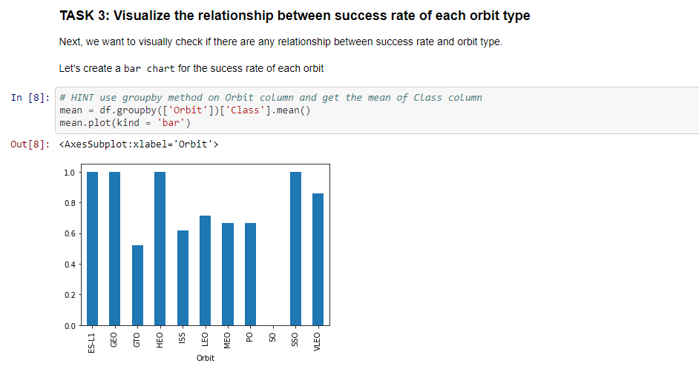
Success Rate vs. Orbit Type

Slide 19
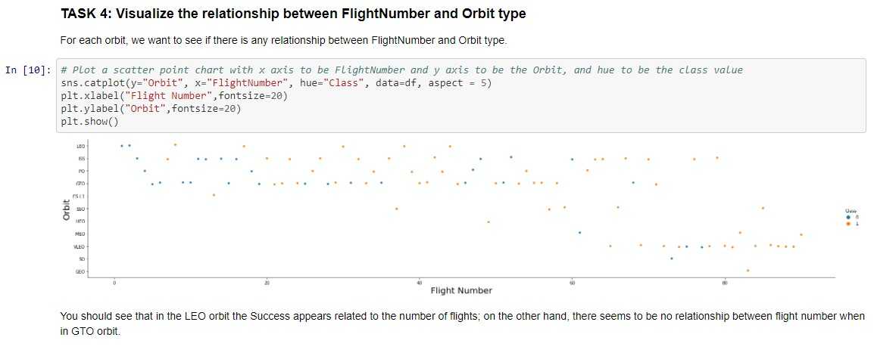
Flight Number vs. Orbit Type

Slide 20
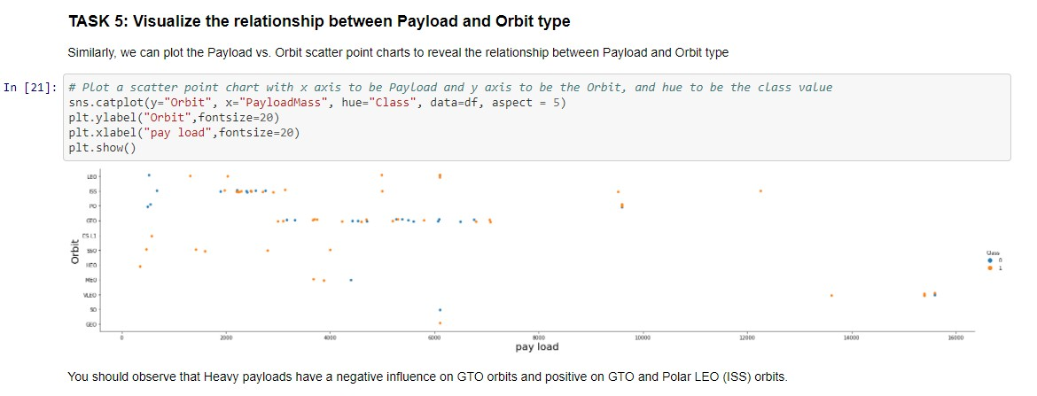
Payload vs. Orbit Type

Slide 21
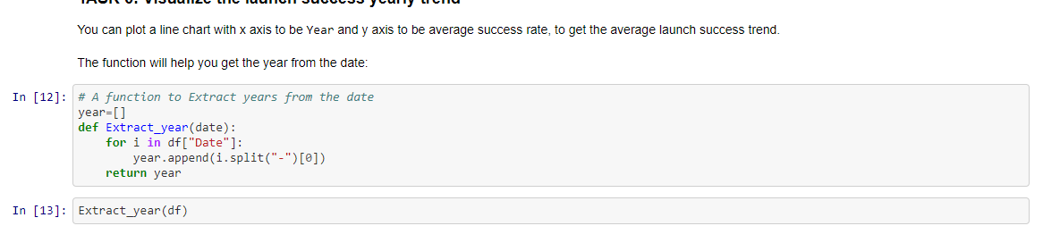
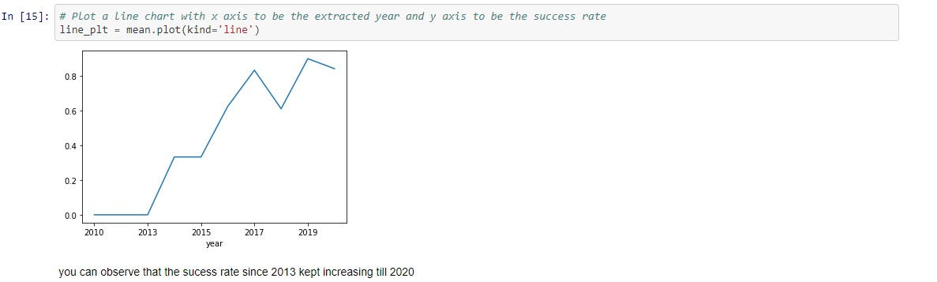
Launch Success Yearly Trend

Slide 22
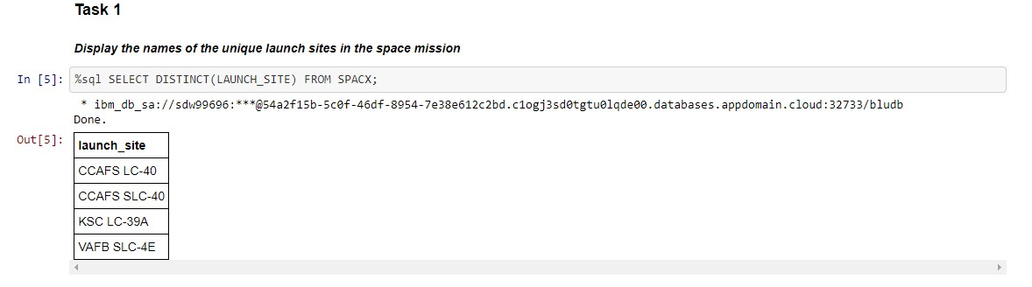
All Launch Site Names

Slide 23
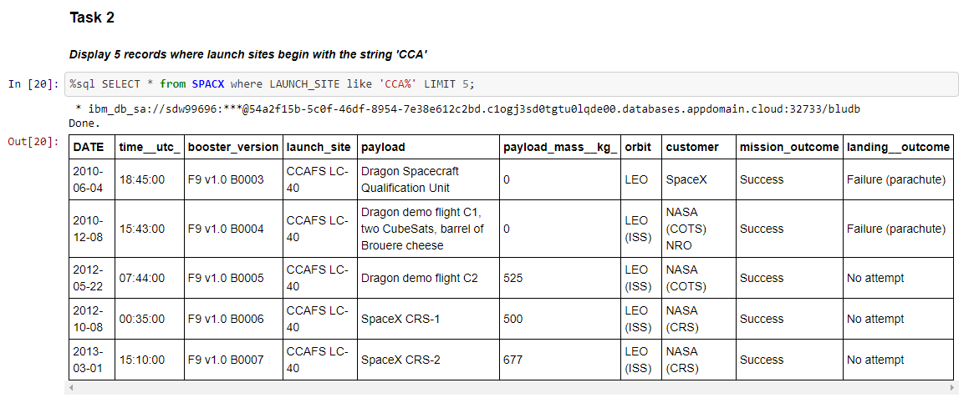
Launch Site Names Begin with 'CCA'

Slide 24
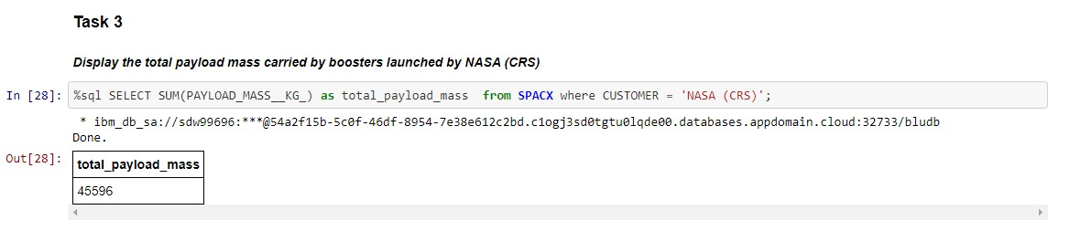
Total Payload Mass

Slide 25
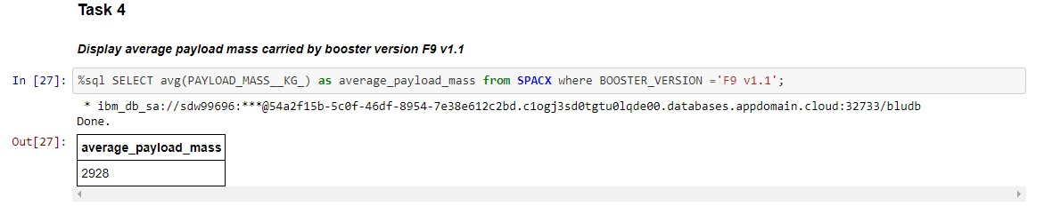
Average Payload Mass by F9 v1.1

Slide 26
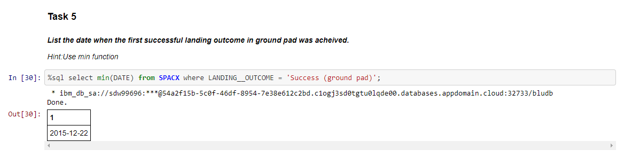
First Successful Ground Landing Date

Slide 27
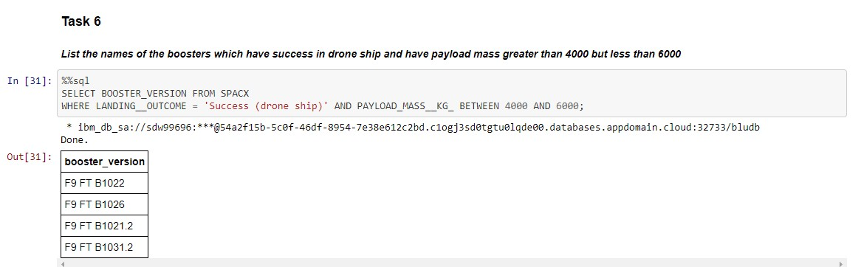
Successful Drone Ship Landing with Payload between 4000 and 6000

Slide 28
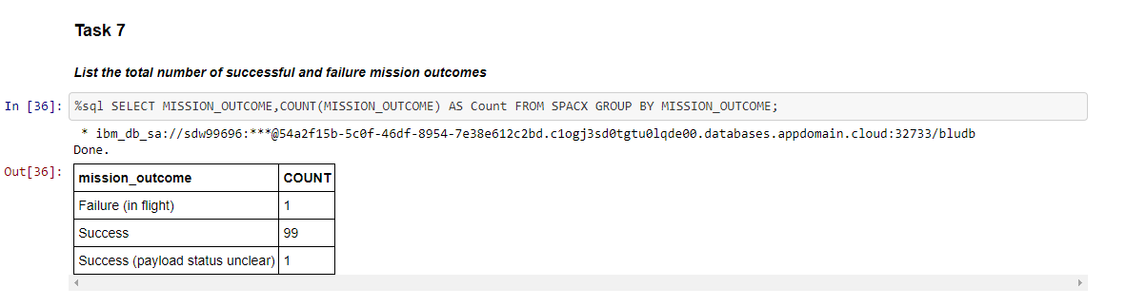
Total Number of Successful and Failure Mission Outcomes

Slide 29
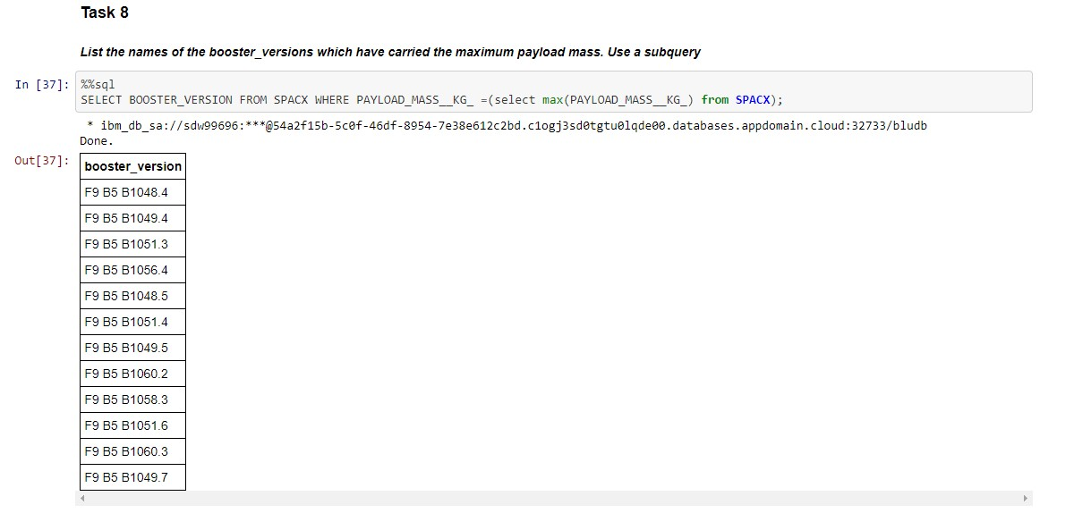
Boosters Carried Maximum Payload

Slide 30
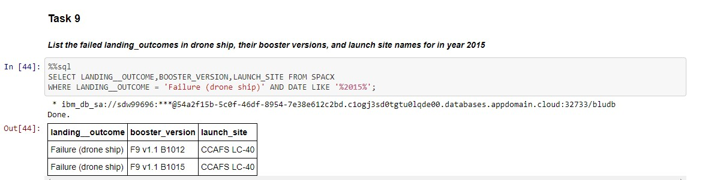
2015 Launch Records

Slide 31
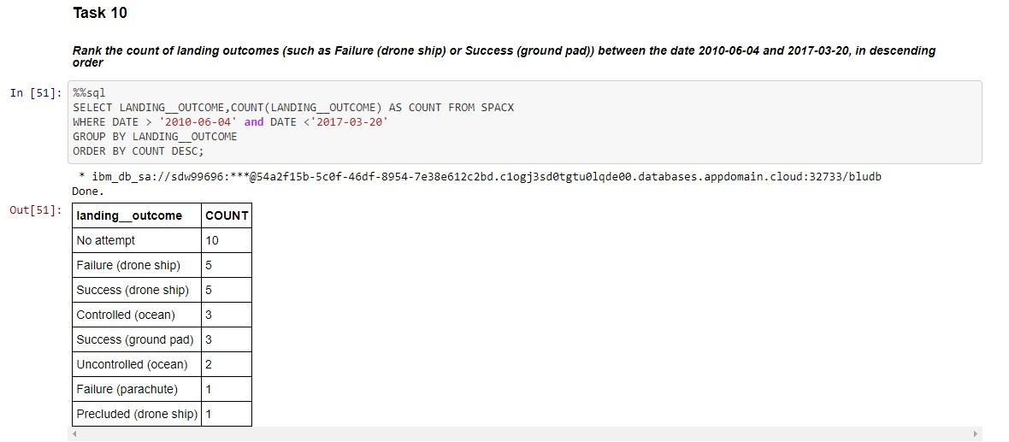
Rank Landing Outcomes Between 2010-06-04 and 2017- 03-20

Slide 32


Slide 33
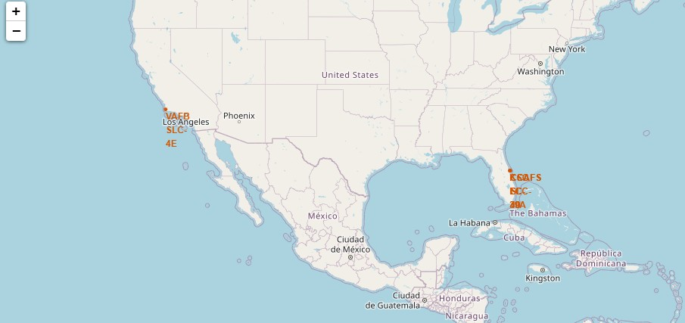
Lunch sites Marking
The markers on this maps show the lunch site locations on the map

Slide 34
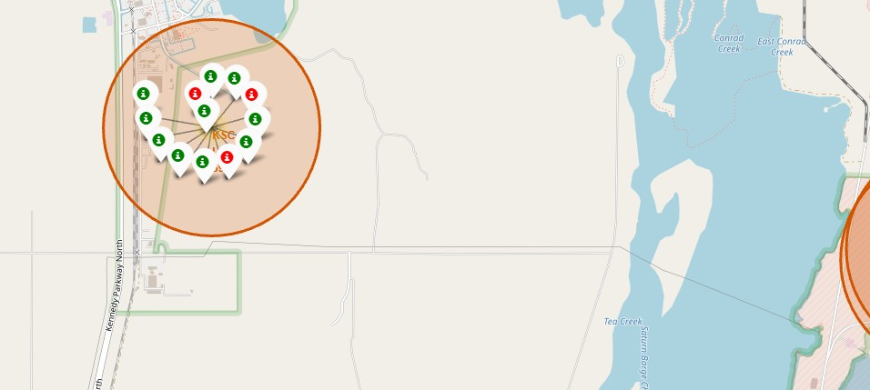
Mark the success/failed launches for each site on the map
A green marker represents a successful landing outcome, while a red one represents failure

Slide 35
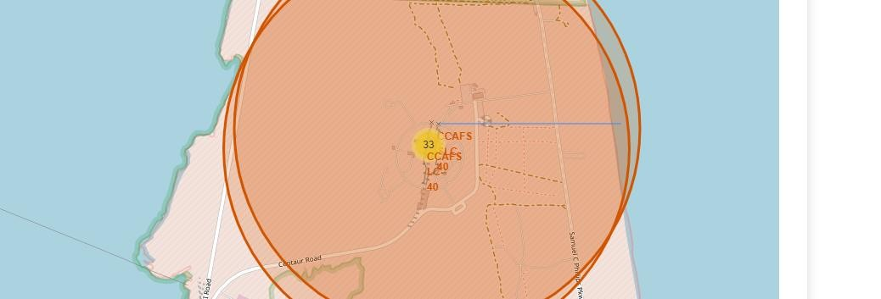
Distances between a launch site to its proximities
The blue line represents the distance between the lunch site and the closest coastline.

Slide 36


Slide 37
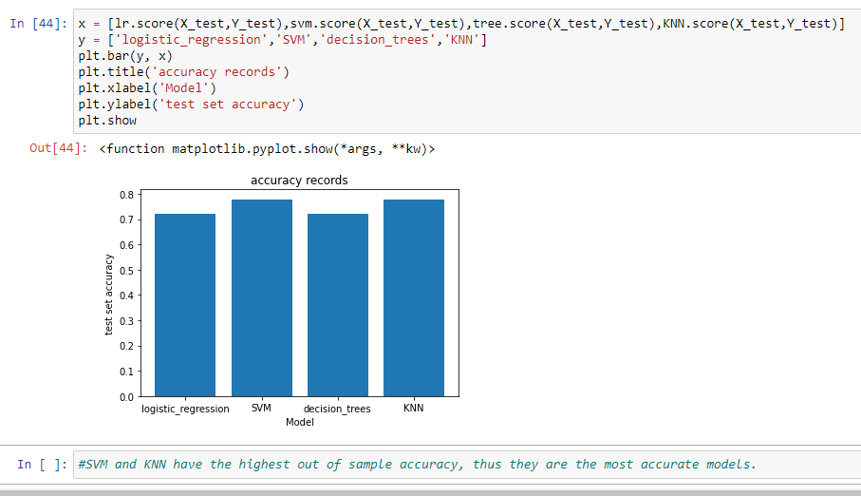
Classification Accuracy

Slide 38
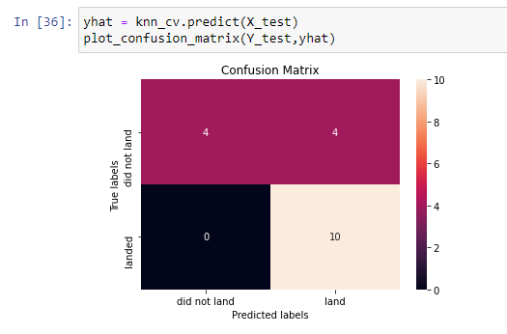
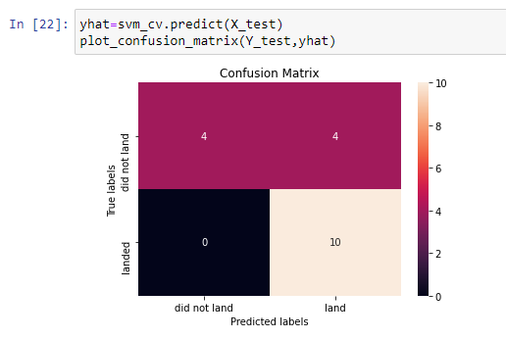
Confusion Matrix
These two graphs represent the confusion matrix for both the SVM and KNN models
These confusion matrices show the largest true positive and true negative values, as well as the least false positive and false negative values.

Slide 39
Conclusions
Not all the data is important, the collected data may contain irrelevant columns and it is normal to drop them.
Visualizing data is a good way of determining what features have the strongest effect.
SQL queries provide wider scope to explore datasets in comparison with traditional
EDA.
SVM and KNN models are the most reliable since they have the highest out of sample accuracy and f1-score.

Slide 40


